Slide 1
Tutorials for PySpark
Tutor: Liu Changshuo
2022

Slide 2
Environment
For Windows : following the steps in the lab1 to download Ubuntu, Java, Maven, Spark, and set the environment
For Mac with M1 or M2 chip : following the steps in lab1 document to get the stand-alone Spark
For Mac without M1 or M2 chip: either configure the environment in downloaded Ubuntu or get the stand-alone Spark
The commands to configure the environment are in the links of Lab1_2022_sem1.pdf or Appendix B

Slide 3
Run and Debug
Run with command spark-submit
Run and Debug with PyCharm(recommended)
Please see the links in Lab1 document about how to get PyCharm and link PyCharm with Spark

Slide 4
1 Configure PySpark
Typically, we just set PySpark as below:
conf = SparkConf()
conf.setMaster("local").setAppName("My app")
sc = SparkContext(conf=conf)
SparkContext is the entry point to any spark functionality.
When we run any Spark program, Driver will start and run the main function
The Driver then allocates different operations to worker nodes

Slide 5
2 Coding
RDD
A list of partitions
A list of dependencies on other RDDs
There are two ways to apply different operations on RDD:
Action: These are the operations that are applied on RDD, which will guide Spark to perform computation and send the result back to the driver.
Transformation: These are the operations that will be applied on a RDD to create a new RDD.

Slide 6
Action
saveastextfile
collect
count
reduce
foreach
first
take
saveassequencefile
countbykey

Slide 7
Transformation
map
join
reduceByKey
filter
groupByKey
groupWith
sortByKey
sortBy
Union
flatMap

Slide 8
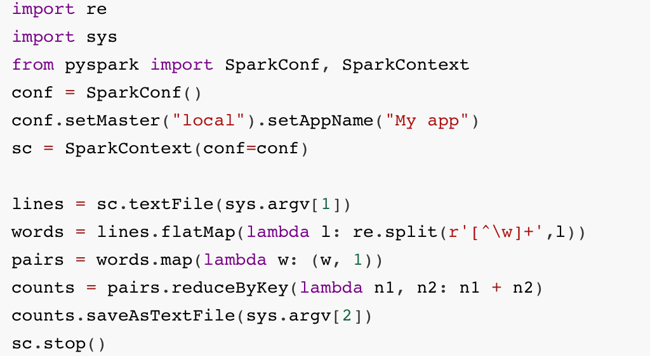
Example - Count word

Slide 9
3 run the code!
Command line:
spark-submit wordcount.py in.txt outfile
Test the Debug of PyCharm
Remember to delete the output dir before running the codes

